Slide 1
Western Countries Financial Data Analysis Capstone Project Presented by Sonam Rai (Business Analyst)
1

Slide 2
Introduction
In this project, we delve into the financial data of Western countries to derive insights and recommendations for strategic business decisions.
We follow six key steps: Ask, Prepare, Process, Analyze, Share, and Act. Let's dive in!

Slide 3
Step 01: - Ask
In this stage, we define the core business problem: "What are the most profitable products, countries, and segments for Western countries to target or avoid?“
Business Objectives:
Optimize Profits: We aim to determine how we can best optimize our profits.
Identify Emerging Trends: We seek to identify emerging market trends that can give us a competitive edge.
Recommendations: We will use these insights to formulate actionable recommendations for our organization.
Deliverables:
A clear, concise summary of our business objectives. A clear, concise summary of our business objectives.
Comprehensive documentation of all data cleaning, manipulation, and analysis.
Formulation of recommendations based on our analysis, designed to guide strategic decision-making.

Slide 4
Step 02: - Prepare
4
Dataset Overview: The dataset comprises 701 rows, with 700 rows dedicated to pure data and one row containing column headers. The recorded data spans two years, starting from the 1st of September 2013 (the first date of transaction) to the 1st of December 2014 (the last shipping date). We've chosen to use this date range to represent two years of business activity. The dataset encompasses information about 5 unique countries, 5 unique segments and 6 unique products.
Data Columns: The dataset consists of 16 columns, each serving as a unique attribute: Segment, Country, Product, Discount_Band, Units_Sold, Manufacturing_Price, Sale_Price, Gross_Sales, Discounts, Sales, COGS, Profit, Date, Month_Number, Month_Name, Year.
In the "Prepare" phase, our primary focus is on understanding and assessing the Western Countries Sales Data, which is provided by SkillAcademy at this link: Western Countries Financial Data. Here's a concise and organized overview of the dataset:

Slide 5
Step 03: - Process
5
Through meticulous data processing, we lay the groundwork for our Excel, SQL, and Power BI analyses, empowering us to unearth valuable insights and attain a competitive advantage.
In the "Process" phase, we will ensure that our dataset is well-prepared and cleaned to facilitate for further analysis. We will utilize Excel for this purpose, as the data is already in XLSX format.
Data Inspection: We examine the dataset thoroughly in Excel.
Missing Data Check: Power Query helps us identify and address missing data, which is fortunately not present in our dataset.
Duplicate Data Removal: We eliminate duplicate rows, ensuring our data remains concise and unique. Also, there are no duplicate data presented in the data.

Slide 6
We approach our data analysis through a structured process, leveraging Excel, SQL, and Power BI to extract insights and drive informed decision-making. Our methodology consists of: Excel Statistical Analysis: Extracting key components, using statistical tools, and presenting findings visually. Excel Graphical Analysis: Developing user-friendly dashboards highlighting insights. SQL Analysis: Manipulating data with SQL queries for deeper insights. Power BI Dashboard Development: Integrating data into Power BI, designing dynamic dashboards for reporting.
Step 04 -Analyze
6

Slide 7
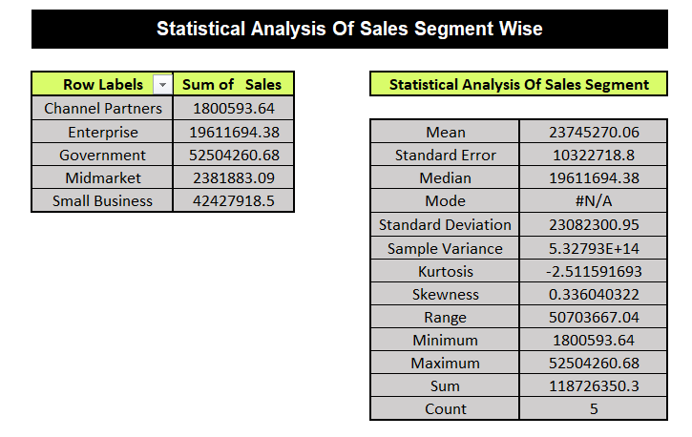
i. Excel Statistical Analysis:
Insights from the segment-wise statistical sales analysis:
Government segment leads with $52,504,260.67 in sales.
Small Business follows closely with $42,427,918.50.
Enterprise segment contributes $19,611,694.38.
Midmarket and Channel Partners segments show comparatively lower sales.
Statistical analysis highlights variability in segment performance, with notable dispersion and a right-skewed distribution.

Slide 8
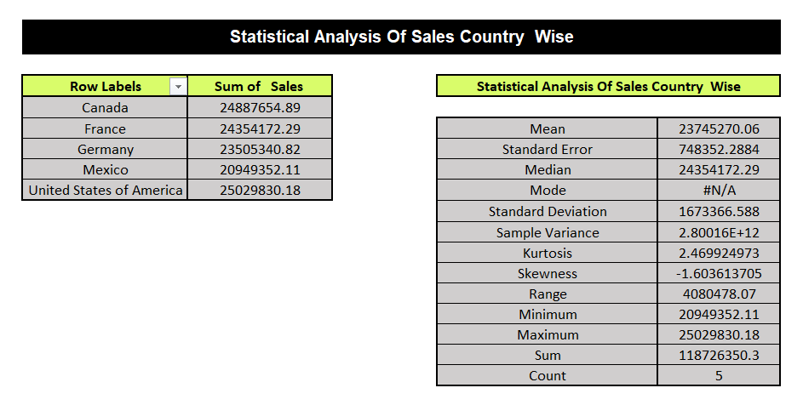
Insights from the country-wise statistical sales analysis: USA leads with $25,029,830.17, followed closely by Canada and France. Germany and Mexico also contribute significantly to total sales. Mean sales amount aligns closely with the United States' sales figure, indicating consistent performance.
Standard deviation and sample variance suggest variability in sales across countries.
Positive kurtosis indicates a relatively peaked distribution, while negative skewness suggests a left-skewed distribution of sales data.

Slide 9
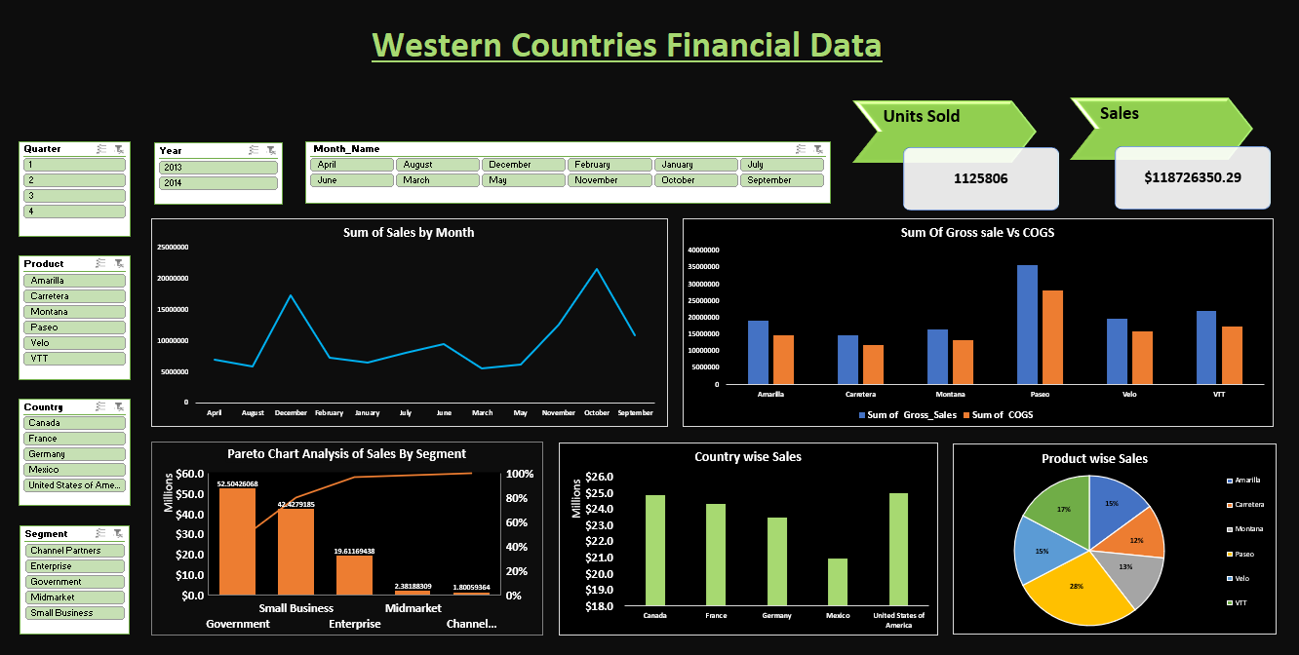
ii. Excel Graphical Analysis: This is my graphical presentation of Western Countries Financial Data: -
9
My Excel Dashboard Link:- Western Countries Financial Data Analysis

Slide 10
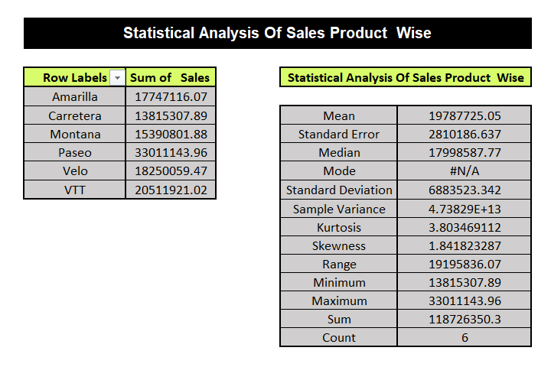
Insights from the product-wise statistical sales analysis: Paseo leads in sales with $33,011,143.95. VTT follows with $20,511,921.02 in sales, contributing significantly to the total. Mean sales amount is $19,787,725.04, indicating average performance. Wide range between the minimum and maximum sales figures suggests variability in product performance. High positive kurtosis and skewness values indicate a distribution skewed towards higher sales figures, with a relatively sharp peak.

Slide 11
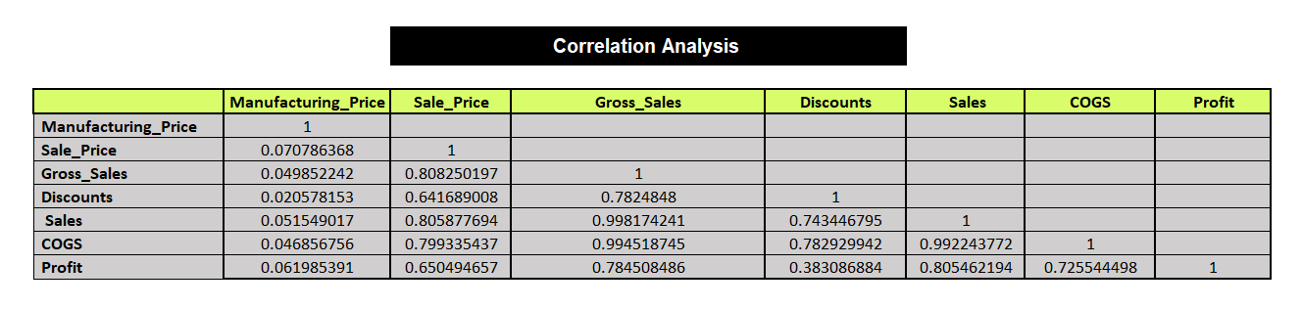
Correlation Analysis of Manufacturing_Price, Sale_Price, Gross_Sales, Discounts, Sales, COGS, Profit is: -
Strong positive correlation between Sale_Price and Gross_Sales (0.8083), indicating higher prices correlate with higher sales revenue.
Moderate negative correlation between Discounts and Gross_Sales (-0.7825), implying discounts may reduce overall revenue.
Strong positive correlation between Sales and Gross_Sales (0.9982), suggesting most sales directly contribute to gross sales.
Strong positive correlation between COGS and Gross_Sales (0.9945), indicating higher sales are associated with higher production costs.
Moderate positive correlation between Profit and Gross_Sales (0.7845), indicating higher sales contribute to improved profitability.

Slide 12
iii. SQL Analysis: Let’s load our data into SQL and check the first 5 rows to make sure it imported well.
Select*
From
Western_Countries_Financial_Data;
In our exploratory data analysis of the Western Countries Financial dataset, we'll focus on analyzing the data to extract valuable insights. We are using My SQL Workbench for our analysis

Slide 13
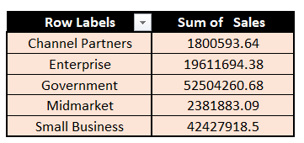
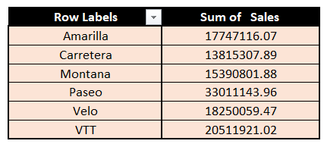
SQL Analysis
A. Product-wise Sales
B. Segment-wise Profit
Select Segment, Round(Sum(Profit),2) As Total_Profit
From Western_Countries_Financial_Data
Group by Segment
Order By Total_Profit Desc;
Select Product, Round(Sum(Sales),2) As Total_Sales
From Western_Countries_Financial_Data
Group By Product
Order By Total_Sales Desc;
Government and Small Business segments show positive profits ($11,388,173.17 and $4,143,168.50 respectively), while the Enterprise segment indicates a loss (-$614,545.62), suggesting potential areas for optimization and focus.
This clearly indicates our top-selling products are Paseo ($33,011,143.97), VTT ($20,511,921.02), and Velo ($18,250,059.48), indicating strong market demand and potential areas for strategic focus.

Slide 14

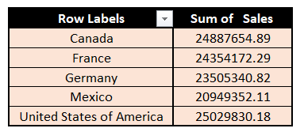
C. Yearly Sales
D. Country-wise Sales
Select Segment, Round(Sum(Profit),2) As Total_Profit
From Western_Countries_Financial_Data
Group by Segment
Order By Total_Profit Desc;
Select Country, Round(Sum(Sales),2) As Total_Sales
From Western_Countries_Financial_Data
Group By Country
Order By Total_Sales Desc;
Yearly sales significantly increased from 2013 ($26,415,255.52) to 2014 ($92,311,094.79), indicating a substantial growth trend over the year. Also, increased because in 2013 our operation was only active for 4 months.
The United States of America leads in country-wise sales with $25,029,830.18, followed closely by Canada ($24,887,654.89), France ($24,354,172.30), Germany ($23,505,340.82), and Mexico ($20,949,352.11), showcasing a competitive distribution of sales across these key markets.

Slide 15

E. Profit and sales by Qtr
F. Yearly profit
SELECT CASE
WHEN Month_Number BETWEEN 1 AND 3 THEN 'Q1’
WHEN Month_Number BETWEEN 4 AND 6 THEN 'Q2’
WHEN Month_Number BETWEEN 7 AND 9 THEN 'Q3’
ELSE 'Q4’
END AS Quarter,
Round(Sum(Sales), 2) AS Total_Sales,
Round(Sum(Profit), 2) AS Total_Profit
FROM Western_Countries_Financial_Data
GROUP BY CASE
WHEN Month_Number BETWEEN 1 AND 3 THEN 'Q1’
WHEN Month_Number BETWEEN 4 AND 6 THEN 'Q2’
WHEN Month_Number BETWEEN 7 AND 9 THEN 'Q3’
ELSE 'Q4’
END
ORDER BY Quarter;
Select Year, Round(Sum(Profit),2) As Total_Profit
From Western_Countries_Financial_Data
Group By Year
Order By Total_Profit Desc;
Quarterly sales and profits show a consistent upward trend throughout the year, with Q4 exhibiting the highest sales ($51,690,077.51) and profits ($7,527,213.50), suggesting a strong performance and potential for strategic planning to maintain growth momentum.
Yearly profits surged from 2013 ($3,878,464.51) to 2014 ($13,015,237.77), indicating a substantial increase and potentially reflecting improved operational efficiency or strategic initiatives implemented during the year.

Slide 16


16
G. Top 2 countries
H. Bottom 3 products
Select Top 2
Country,Round(Sum(Sales),2) As Total_Sales
From Western_Countries_Financial_Data
Group By Country
Order By Total_Sales Desc;
Select Top 3
Country,
Round(Sum(Sales),2) As Total_Sales
From Western_Countries_Financial_Data
Group By Country
Order By Total_Sales Asc;
The United States of America and Canada dominate sales figures, with the USA leading at $25,029,830.18 closely followed by Canada with $24,887,654.89, underscoring the significance of North American markets in revenue generation.
Mexico, Germany, and France rank among the bottom three countries in terms of sales, with Mexico leading at $20,949,352.11, followed by Germany with $23,505,340.82 and France with $24,354,172.30, indicating variations in market performance and potential areas for targeted improvement strategies.

Slide 17
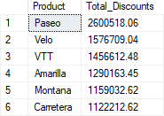

I. Product wise discount
J. No. of units sold year over year
Select Product, Round(Sum(Discounts),2) As Total_Discounts
From Western_Countries_Financial_Data
Group By Product
Order By Total_Discounts Desc;
Select Year, Sum(Units_Sold) As Total_Unit_Sold
From Western_Countries_Financial_Data
Group By Year;
Discounts are allocated to products as follows: Paseo receives $2,600,518.06, Velo receives $1,576,709.04, and VTT receives $1,456,612.48, indicating varying levels of discounting across product lines, potentially influencing customer purchasing behavior and product profitability.
Unit sales experienced a significant increase from 2013 (264,674 units) to 2014 (861,132 units), reflecting a growth of approximately 225.84%.

Slide 18
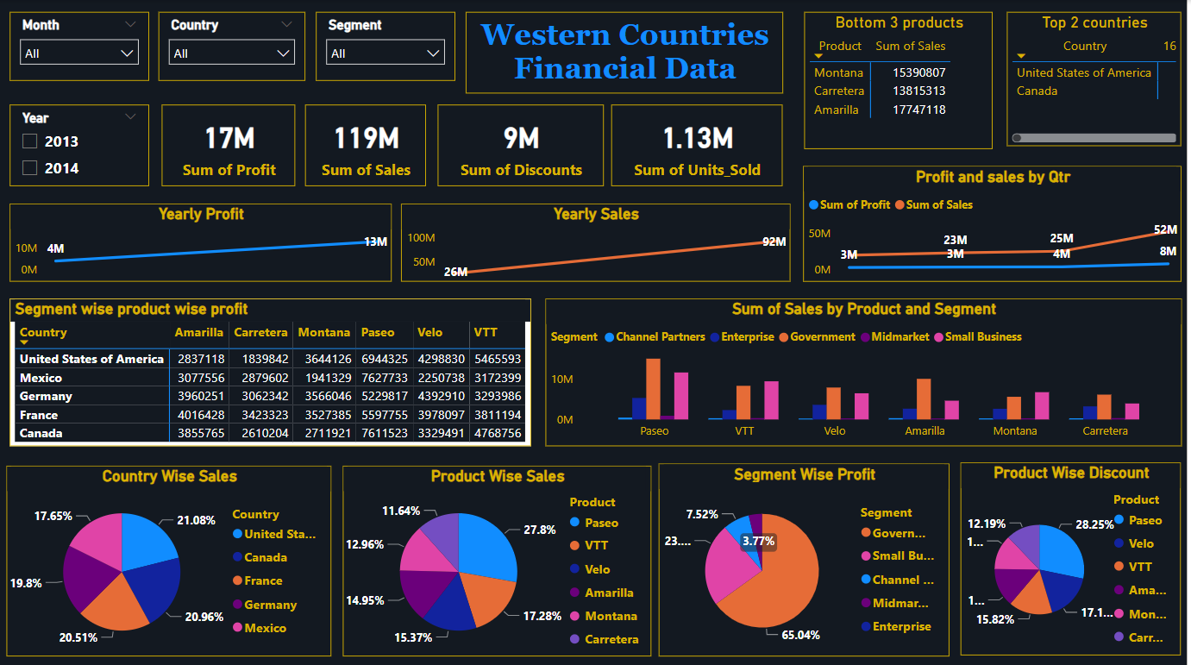
iv. Power BI Dashboard Development:
Power BI Dashboard of Western Countries Financial Data
My Excel Dashboard Link:- Western Countries Financial Data Analysis

Slide 19
Analyze
Statistical Analysis in Excel
Explore data distributions, trends, and correlations.
Perform descriptive statistics.
Identify outliers and anomalies.
Visualization Dashboard in Excel
Create visual representations of key metrics.
Design interactive dashboards for data exploration.
SQL Database Import
Establish database schema.
Import data into SQL server.
Verify data integrity through queries.
PowerBI Visualization
Develop interactive visualizations for deeper insights.
Answer key business questions through dynamic dashboards.
Dashboard Slides (Empty)
Product wise Sales
Segment wise Profit
Yearly Sales
Country wise Sales
Profit and Sales by Quarter
Yearly Profit
Top 2 Countries
Bottom 3 Products
Product wise Discount
No. of Units Sold Year over Year
Segment wise Product Sales
Segment wise Product wise Profit

Slide 20
Conclusion and Inferences
There is Impressive Growth in Sales in 2014 as compared to 2013 year.
The United States of America has phenomenal record in Terms of Overall Sales.
Paseo has the highest share as compared to other products.
Through, Pareto Chart analysis, Government and Small Business Segment shares almost 80% of sales in 2013 and 2014.
There is trend noticed , sales in December months is highest as Compared to other months.
Through comprehensive data analysis and visualization, we've uncovered valuable insights into the financial landscape of Western countries. Our findings provide actionable recommendations for maximizing profitability and strategic growth opportunities. This project demonstrates the power of business analytics in driving informed decision-making

Slide 21
Thank you

